Slide 1
New to burning man?
10
things you should know before you go
Notes:
You’ve probably heard a lot about Burning Man already. Some of it may even be true!
To make it more fun, we’ve organized it into a Top 10 list. Who doesn’t like a top 10 list?

Slide 2
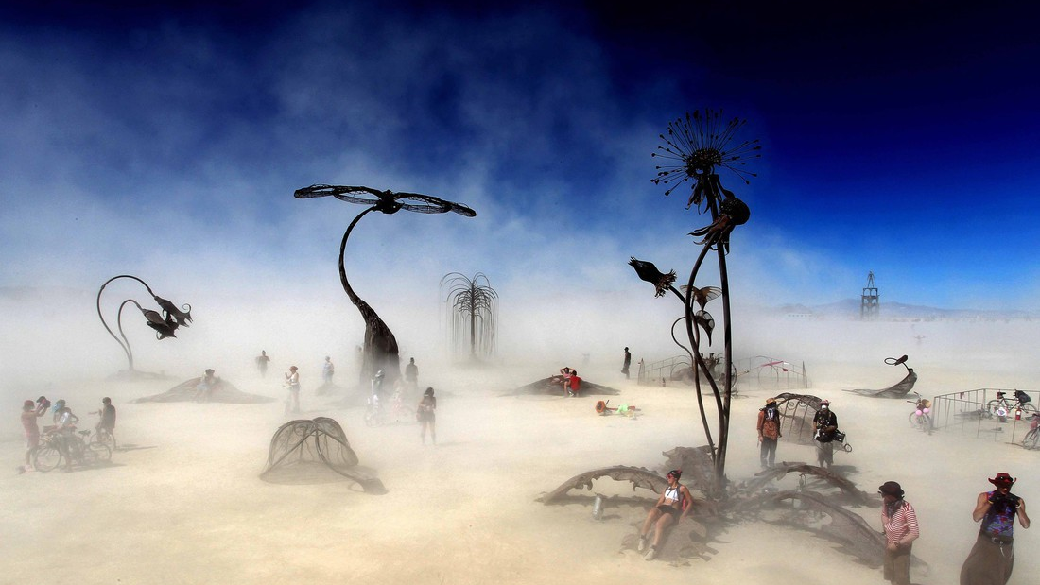
1 It’s not a music festival.
Notes:
Number 1. Burning Man is not a music festival. In fact it’s not even really a festival in the normal sense of the word.

Slide 3
All entertainment is DIY
There’s no VIP anything
It’s mostly run by volunteers
There’s hardly any vending
You must ‘pack out your trash’
Notes:
All entertainment is DIY – Radical self-expression, immediacy
There’s no VIP anything – Radical inclusion
It’s all run by volunteers – Participation, communal effort
There’s hardly any vending – radical self-reliance, gifting, decommodification
Bring your own trashcan – Leaving no trace, civic responsibility

Slide 4
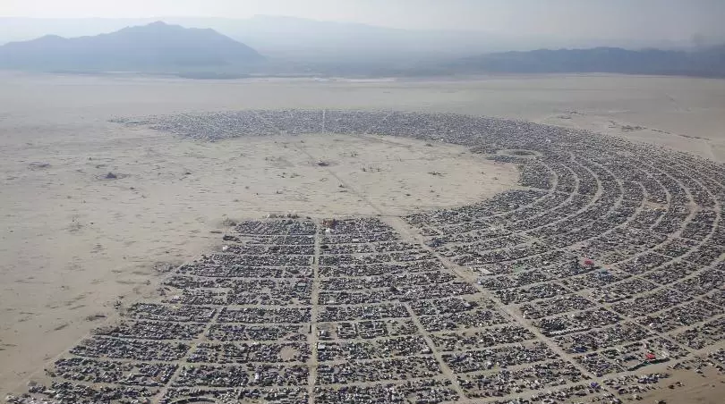
Inclusion
Self-reliance
Self-expression
Participation
Immediacy
Leaving no trace
Communal effort
Gifting
Decommodification
Civic responsibility
Notes:
At Burning Man we have a set of ten principles that we like to call (wait for it): the Ten Principles! Not rules, but guidelines for how we like to relate to each other. More on this as we go along.

Slide 5
So if it’s not a festival, what is it?
A city
A culture
A community
Notes:
So if it’s not a festival, what the heck is it?
It’s a city of 75,000 people. It’s temporary but it’s not some kind of off-the radar autonomous zone. For a week every year it’s the third largest metro area in Nevada.
It’s a cultural movement, made up of people who like to make their own culture, not buy it off the shelf.
And it’s a community, made up of people from all walks of life. It’s not for everyone, but everyone’s welcome to join. You may already be a member!

Slide 6
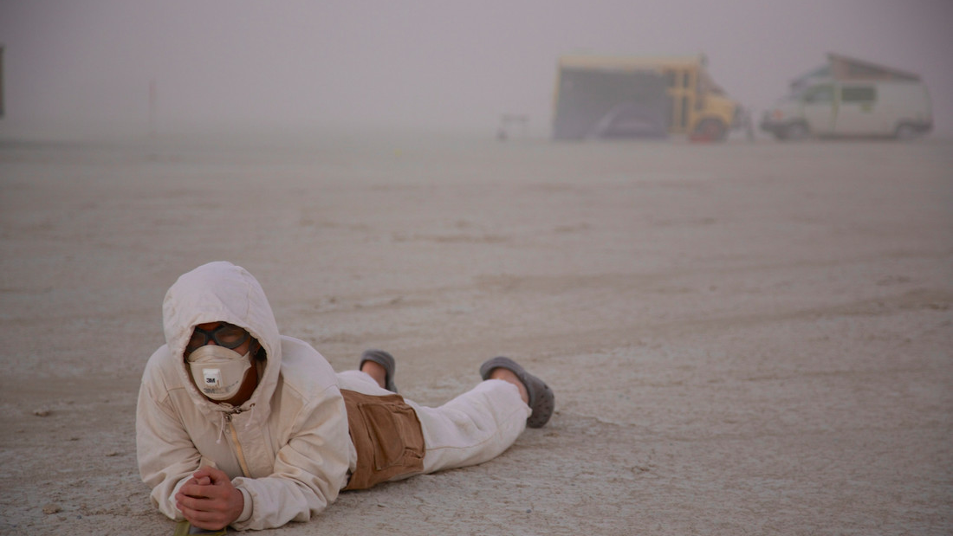
2 It takes place outdoors. In the
desert. In the elements.

Slide 7
Low humidity
Dry, alkaline environment
8-10% humidity
Challenging to stay hydrated
Notes:
First off, it’s dry. Ridiculously dry. So dry you’ll hardly feel yourself sweat, because it evaporates as soon as it hits your skin. With only a tiny fraction of the relative humidity you’re used to, it’s a constant struggle for humans to stay hydrated. If you don’t drink water – a lot of water – you can get sick. And as we all know, alcohol and drugs accelerate the process. So do water. If your mouth feels dry, it’s too late – you’re already dehydrated. The best way to monitor your hydration health is to keep an eye on the color of your urine. The clearer, the better.

Slide 8
High altitude
4,000 feet elevation
Sea-level life forms may need a few days to get acclimated
Notes:
Next, though it’s the desert floor, it’s actually 4,000 feet above sea level. Humans coming from lower altitudes may take a few days to get acclimated. Do yourself a favor and take it easy your first day on the playa. Stay cool, drink water, and don’t push yourself too hard.

Slide 9
Extreme temperatures
Hot days
Sunscreen, hat, sunglasses
Beware: sunlight bounces up
Cold nights
Layered clothing
Notes:
It’s a desert, so you know it’s going to get hot. But what a lot of people don’t know is that once the sun goes down, it can get quite cold. The temperature differential between Noon and Midnight can be 40 or 50 degrees Fahrenheit.
When the sun’s out, protect yourself: sunscreen, hat, sunglasses, check check check.
Pro tip: the sunlight bounces up off the white lakebed, and if you don’t watch out you can get sunburned on the underside of your chin. Unless you wear a beard, in which case never mind.

Slide 10
Playa Dust
Super fine, gets everywhere (3x finer than talcum powder)
Keep tent doors & flaps closed when not in use
Alkaline (pH 10) & mildly corrosive
Vinegar or lemon will neutralize it
Notes:
In prehistoric times, the desert under our city was a massive lake, and the lakebed is still filled with miles of silt – also known as playa dust. Three times finer than talcum powder, it has a way of getting into everything.
It’s alkaline enough to be corrosive, which means it sticks to surfaces and doesn’t want to come off with plain water. To get it off your skin, or your gear, or anything, you can use a mild acid solution to neutralize it. Lemon juice is good, and so is vinegar.
Playa dust is unavoidable, but you can take steps to minimize its effect on your life. Like keeping your tent door shut, covering your bedding with a drop cloth, and keeping your car windows rolled up. After a few days in the dust, you’ll be glad you did.

Slide 11
High winds
Winds can reach freeway speeds
Secure your camp: use heavy tent stakes
Expect sudden gusts at any time – don’t leave stuff lying around
Be extra vigilant while setting up and breaking down
Notes:
Ever stick your head out a car window on the freeway? Or check out your dog when he’s doing it? That’s what it’s like when the winds pick up on the playa. Anything that’s not secured can go flying, including tools, tents, construction materials – we had a volunteer get hit in the neck by an airborne sheet of plywood a few years ago; he was lucky it didn’t kill him.
The air may be perfectly still when you arrive, but the winds can kick up out of nowhere at any time, so stake down everything, and don’t leave stuff lying around. Be extra careful during set-up and tear-down, and never walk away from a half-built camp.

Slide 12
White-outs
Take shelter or shelter in place
Wait it out – don’t try to navigate
Could be an opportunity to meet new friends!
Notes:
Even a moderate wind can pick up enough playa dust to cause a whiteout, with dust everywhere and little to no visibility. And it can happen at any time, so you should always be ready with your goggles and dust mask.
When it really kicks up and you can’t see, take shelter wherever you can find it, even if it just means sitting down and waiting it out. Do NOT try to drive or bike in low visibility, just stop and wait it out.
If you’re on Gate road coming in or out, traffic will be stopped until it clears, so relax and enjoy each others’ company. Who knows, you might meet some new friends in the dust.

Slide 13
Storms
Rain showers usually short duration – take shelter and wait it out
Mud sticks to shoes, bike tires, everything – and dries like concrete
Please stay off the roads when wet
Please don’t be a lightning rod
Notes:
It doesn’t rain that often, and when it does, it’s usually over quickly – squalls and showers rather than true storms. So sit tight and wait it out, and please stay off the roads when they’re wet – driving, biking, or even walking can tear them up pretty badly, and when they dry out again they’ll be rough as hell.
Plus, the mud gets stuck to everything – your feet, your bike tires - and you can’t really get it off until it dries rock-hard, and you can knock it off with a hammer.
Oh, and be aware that thunderstorms are pretty common. So you might want to come down off the roof of that RV when it storms, and don’t go waving long pieces of rebar around.

Slide 14
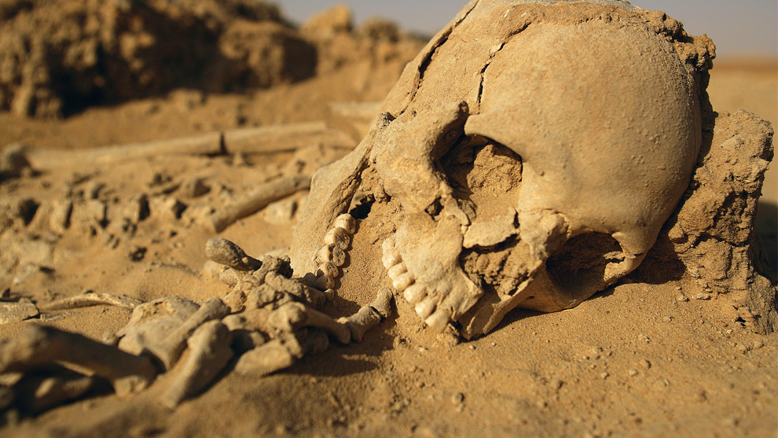
The desert does not care about you.
desert. In the elements.
Thank you for not dying at Burning Man!
Notes:
So what have we learned so far? Basically that the desert is not your friend, and does not care about you. Burning Man is a lot of things, but it’s always a survival situation, so take care you don’t end up like this guy.

Slide 15
RADICAL SELF-RELIANCE
“
Burning Man encourages the individual to discover, exercise and rely on his or her inner resources.
“
Notes:
Radical self-reliance: it’s one of our core values, and you should take it to heart. “Discover, exercise, and rely on your inner resources.” We believe in taking care of each other too, we call that communal effort – but ultimately it’s up to you to take charge of your own experience and your own well-being.

Slide 16
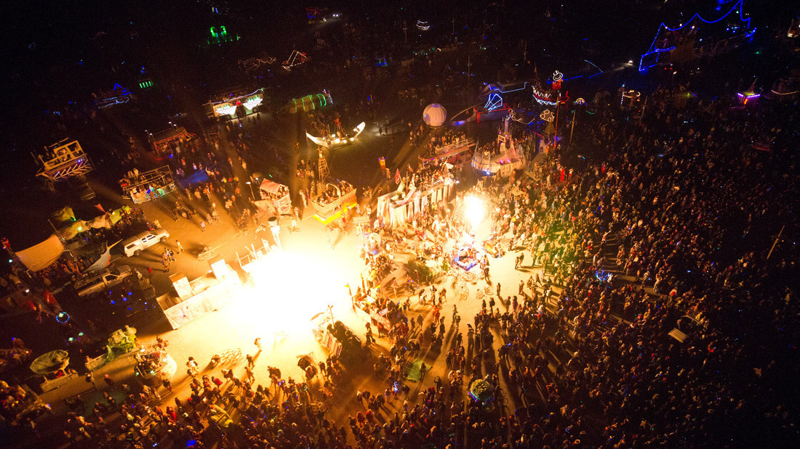
3 It’s a city. Population 75,000.
Notes:
Number five: we call it Black Rock City for a reason. Because it is, in fact, a city. For one week every year it’s a pretty big deal – comparable in size to Santa Fe New Mexico. In this section we’re going to talk about city life, and how to be street-smart in our dusty metropolis.

Slide 17
Law enforcement
A different kind of participant; many volunteer to work the event because they want to go to BURNING MAN.
Give them the benefit of the doubt - say hi, talk about the art!
Notes:
Laws are enforced in Black Rock City by law enforcement officers from the federal Bureau of Land Management and the county Sheriff’s department. The BLM rangers come from all over the country to be here and work the event.
Under the uniform they are in fact people like you and me – so give them the benefit of the doubt and think of them as fellow participants. Which they are! Radical inclusion! Say hi, start a conversation – talking about the art is always a good icebreaker. Or the weather: “So what about this heat, huh?”

Slide 18
Law enforcement
Local, state and federal laws apply
Open container laws in vehicles
Serving alcohol to minors
Searching, warrants, safety
if one person in your camp is committing a crime, they may search the entire camp - don’t be that person!
Notes:
In addition to the obvious, be aware that alcohol laws are enthusiastically enforced, including open containers in vehicles and giving alcohol to minors. If you tour the theme camps, you will run across quite a few gift bars where liquor is being served – you can expect to be carded at all of them, so bring your ID. And if you are lucky enough to be behind the bar in one, you get top do the carding.
All the laws of the land apply, including the US constitution. If you don’t consent to a search, say so. But be advised that you may be searched anyway, if the officer believes there is probable cause. Also be aware that if one person in your camp or in your vehicle is suspected of committing a crime, the entire camp or car can be searched. So don’t be that person – on behalf of your friends, we thank you in advance.

Slide 19
City Layout
Center Camp
Notes:
The city is laid out like a clock, with the man at the center of the clock face. Radial streets are numbered like the numbers on a clock, and the circular streets are named by the letters, A through L as you go away from the Man, back into the neighborhoods.
CENTER CAMP is the civic hub of Black Rock City. There you will find service-oriented camps.
You’ll get a map at the gate, and all the streets will be marked. That is unless someone claims a street sign as a souvenir – PLEASE DON’T BE THAT PERSON.
Once you learn the system it’s pretty hard to get lost – unless you want to get lost. In which case, by all means get lost. This could be the best and safest city in the world to get lost in.

Slide 20
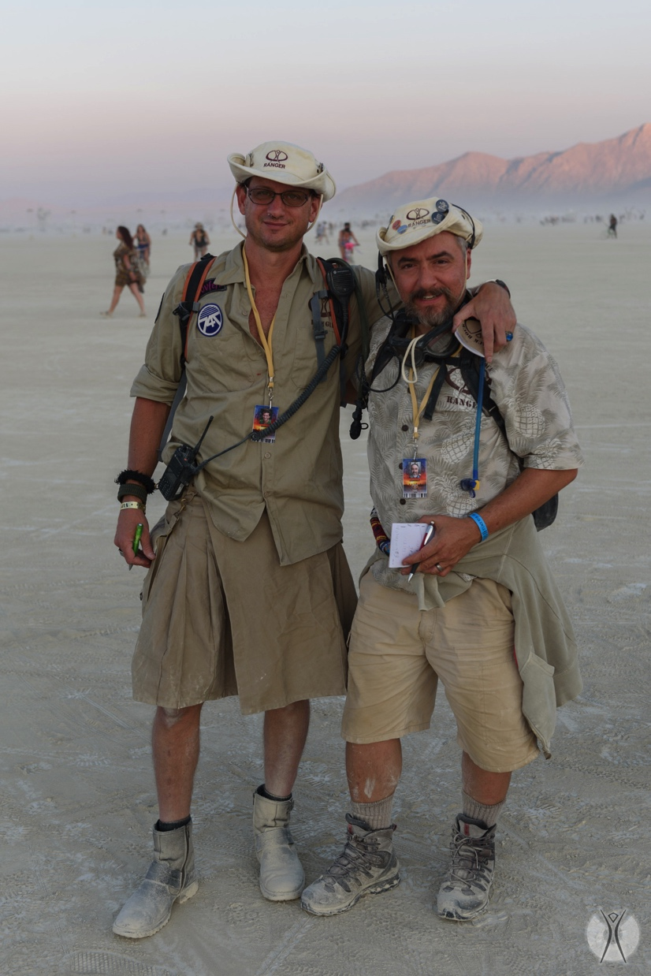
Black Rock Rangers
Not law enforcement!
Provide information
Help de-escalate & resolve disputes
Maintain safety for people, not objects
Notes:
The Black Rock Rangers, on the other hand, are NOT law enforcement. Easily recognized by their Burner-chic khaki uniforms and Burning Man logo gear, this all-volunteer force specializes in non-violent communications, dispute resolution, and de-escalation of situations that could use some de-escalating.
They’re also a reliable source of information, and they can call in other support staff like fire, medical, or law enforcement if the situation requires it.
They’re there to protect people, not property – so don’t expect them to find your lost bike.
And did I mention that they are not COPS? They’re not cops. They’re some of the hardest working volunteers on the playa, so show them a little love.
You can find Ranger stations at Center Camp and the plazas at 3:00 and 9:00 and “B” Streets, and walking patrols throughout the city.[TS]

Slide 21
Emergency Services
Burning Man has a fire department to put out things that are NOT supposed to be on fire, and to support planned art burns
Fire, Medical, Radio support & dispatch, law enforcement coordination
Notes:
We hope you never need them, but Burning Man has a fire department, a medical staff, and a bunch of clinics. There’s also a massive radio network that links them all together, and ties them in to third party services like law enforcement if the need arises. If you’ve got an emergency, look for anyone with a radio. Or just start hollering.

Slide 22
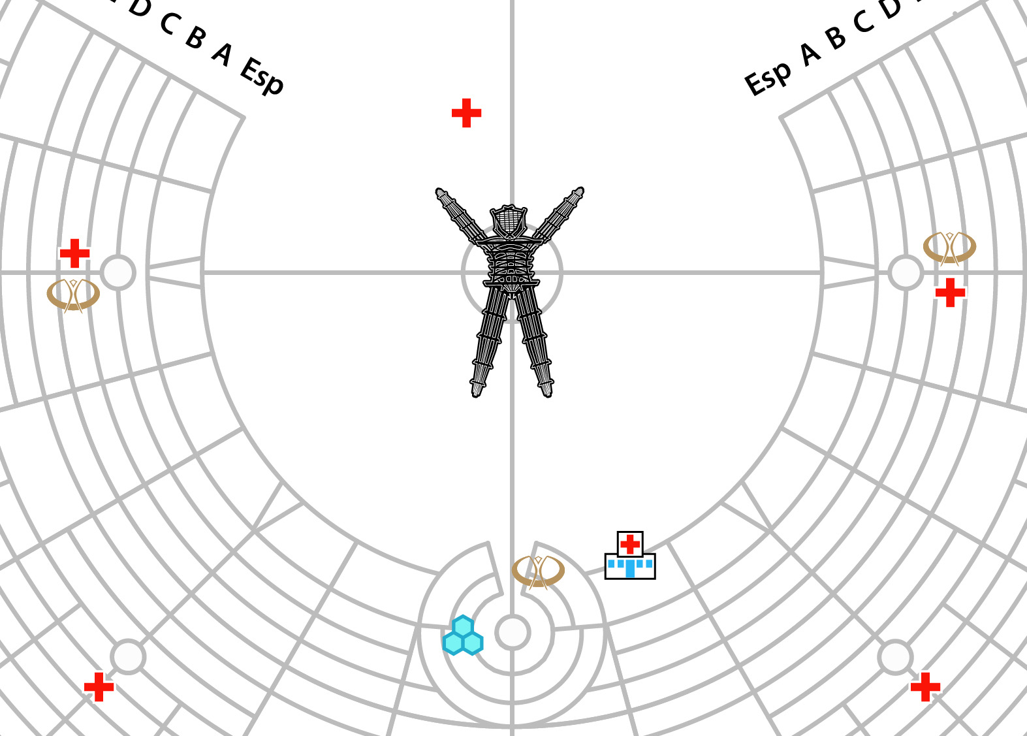
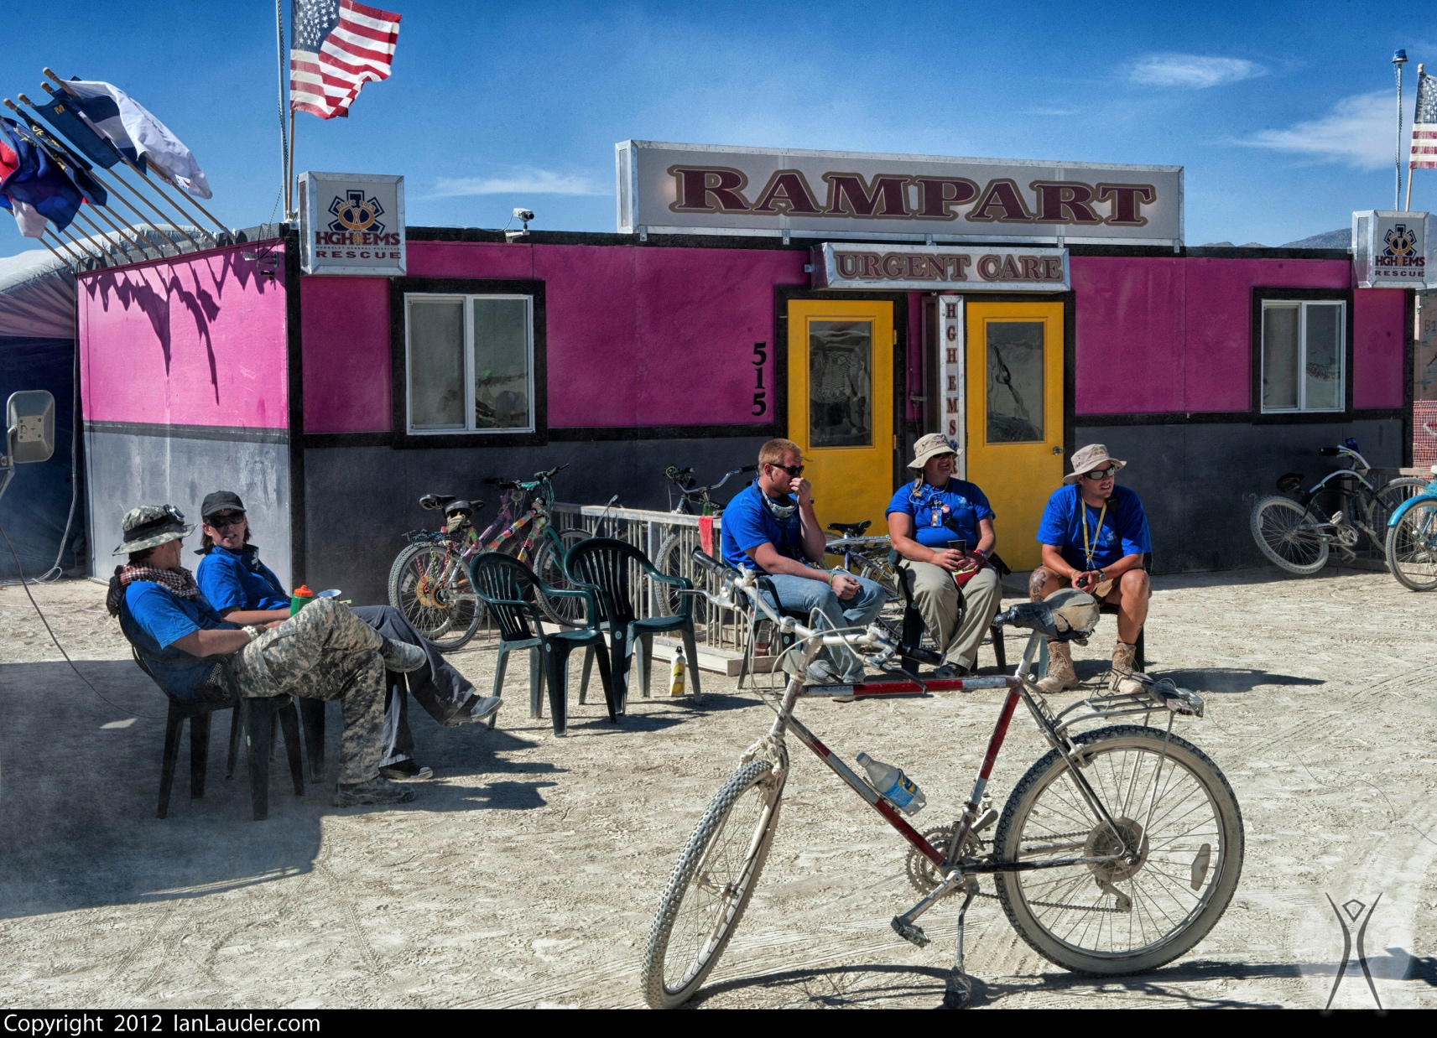
Medical Services
Notes:
Located at 3:00 plaza, 9:00 plaza, and Esplanade at 5:15.
First aid stations at the smaller plazas at 4:30 and 7:30
Second line of defense, if you can’t fix it yourself with your first aid kit
Can do things up to and including set simple fractures, x-rays, etc

Slide 23
Mental Health
Psychiatric services
Crisis intervention (sexual assault, domestic violence)
Notes:
Medical staff and Black Rock Rangers can also hook you up with mental health care if required. That includes crisis intervention, psychiatric help, or even just holding someone’s hand through the long night and talking them down from a bad trip.
Just go to a med station or flag down a ranger if you or someone in your camp needs help.

Slide 24
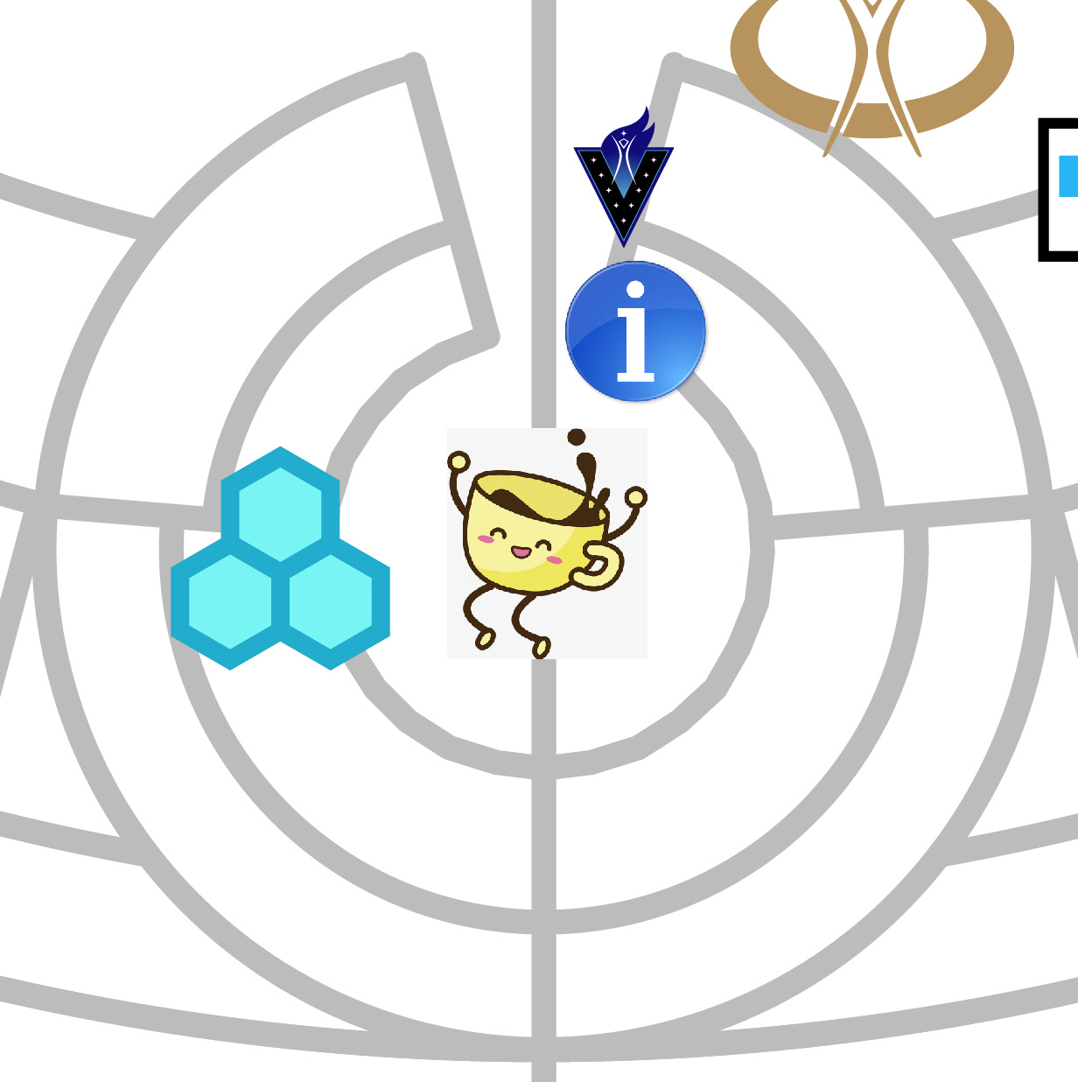
Playa Info
24/7 Directory: Register your camp, find your friends
Lost and Found
V-Spot next door: find out about volunteering
Notes:
Right on the Center Camp circle you’ll find Playa Info, another all-volunteer resource designed to reconnect you with your lost stuff or lost friends.
If you stop by and register your camp, friends will be able to find you too. It’s also the best place on the playa to find out about just about anything from the all-knowing Oracles.
And if you go next door to the V-Spot, you can find out about volunteer opportunities, and maybe sign up for a shift with one of the teams. (alsoat 3:00 and 9:00 plazas)

Slide 25
BMIR 94.5
Burning Man Information Radio
Gate, Exodus, and weather info
Bring a hand crank or battery-op radio!
Year-round: BMIR.org
Notes:
There are a lot of radio stations on the dial, but the “official” channel is 94.5, Burning Man Information Radio. Like everything else in Black Rock City it’s a volunteer operation, but this is the crew that works most closely with our communications team.
In addition to unpredictable and eclectic entertainment, you can get accurate weather, traffic, and official-type announcements.
It’s worth bringing a radio along – maybe one of those hand-crank jobs if you have one.
You can even listen before or after your trip, online at bmir.org.

Slide 26
Yellow bikes
Bike Crew maintains a big fleet of bikes that are provided to the community
Bikes are actually green, with “Yellow Bike” written in red paint
Do not lock up these bikes (1-way ride)
Do not decorate or alter
Notes:
Yes we know they’re actually green, but they have the words YELLOW BIKE written on them in red paint.
Another handy volunteer service, the bike crew maintains a huge fleet of these marvelous beaters.
Please don’t decorate, alter, or lock them – they are for everyone to use, not just you.
If you ride one, expect it to be a one-way trip – as soon as it’s parked, it’s fair game for anyone else to grab.

Slide 27
Arctica - Ice Sales
Ice is our friend, keeps our food from killing us
You need cash for ice! $4/bag
3 Locations: Center Camp Circle, 3:00 and G, 9:00 and G
Notes:
You can buy ice at any of the three Arctica locations. Unless you’re living on dehydrated survival rations,
you probably have some stuff in the cooler that needs to stay cool. Or at least some beverages, right?
It’s four bucks a bag, cash only, so bring some cash. Proceeds all get donated to worthy local causes.

Slide 28
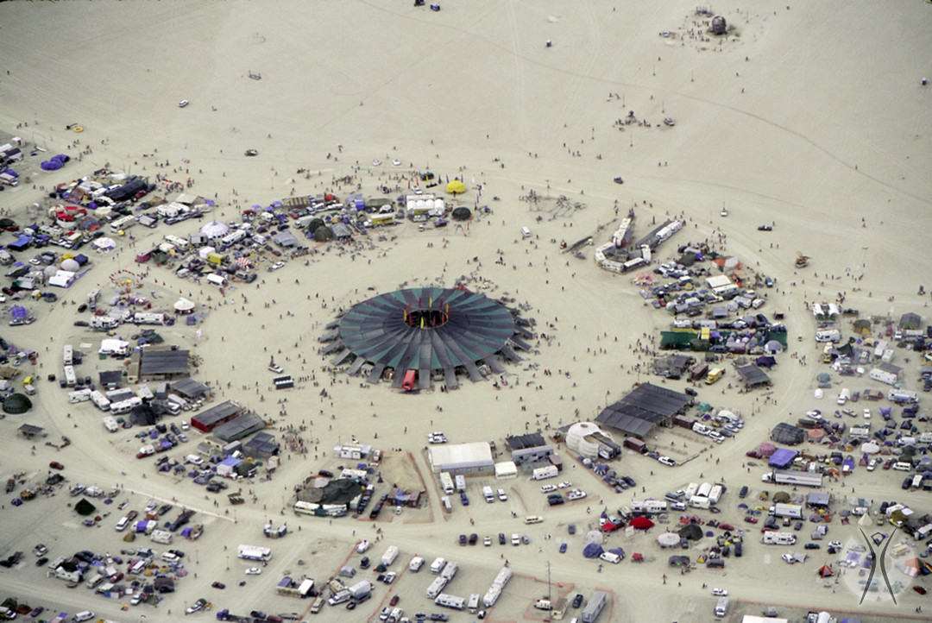
Center Camp Cafe
[TS suggested rev.]
Notes:
Acres of shade, good place to meet friends (old or new)
2 small stages for radical self-expression
Coffee! Beverages! (Proceeds benefit local community)
The only other place in the city where you can buy anything is the Center Camp Café, where you can get a beverage.
Center Camp also has the city’s biggest shade structure and lots of volunteer-driven activities, including two small stages.
Once again, it’s cash only please – and like with ice sales, all profits are donated to our deserving Nevada neighbors.

Slide 29
ARTery & Everywhere
ARTery
Great place to learn about the art, and what’s burning when
Everywhere pavilion
Info about Burning Man’s year-round activities and nonprofit work
Notes:
Close to where 6:00 meets the Esplanade, you’ll find two adjoining spaces, the ARTery and Everywhere. ARTery is where our art support services team is headquartered, and it’s a great place to learn about the art and the artists, including the schedule of what’s going to be burned and when.
The shady Everywhere pavilion next door is where you can learn more about Burning Man’s year-round work, like the 60+ other events that take place around the world, our growing regional network, and the humanitarian work of Burners Without Borders.

Slide 30
Media Mecca
Press and media registration
Any professional project needs a media agreement – cameras get tagged
Personal photos are okay, but please don’t be a creeper!
Notes:
If you’re thinking of publishing anything about Burning Man, including blogging about it, you need to stop by Media Mecca, near Arctica in the Center Camp area.
Personal photos are fine but if it’s a professional project, you’ll need a media agreement.
And even if the photos are just for you and your friends, show some class and ask first before you take anyone’s picture, ok?

Slide 31
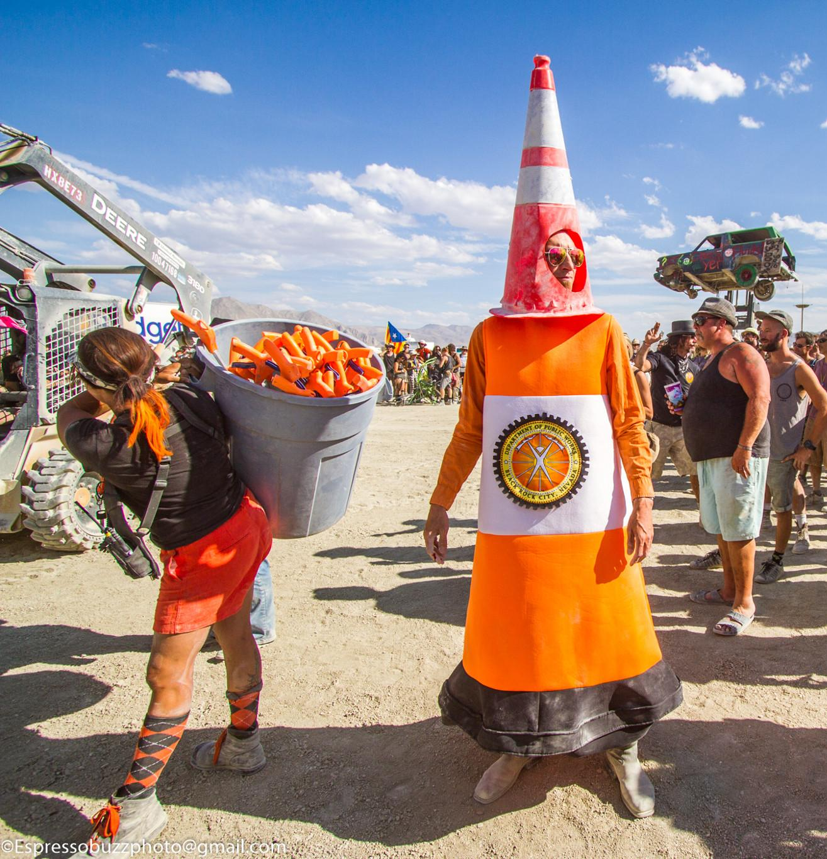
DPW
Set up and take down the city infrastructure
On site for 2-3 months prior
Playa restoration after you leave
Notes:
If you see some colorful characters rolling around in Mad Max trucks, that’s probably DPW, our department of Public Works.
If they look a little crispy around the edges it’s because they’ve been out here for months laying down the city infrastructure.
And they’ll be the last ones to leave when it’s all over – Playa Restoration is a DPW team, responsible for getting us through our post-event MOOP inspection. So we can do it again next year. Hooray for next year!

Slide 32
Other volunteer services
Bike repair shops, massage and body work, recovery groups, etc, etc.
Too many to list – check your What Where When guide for info
Notes:
There’s a hundred and one other services on the playa, all given as gifts, from bike repair to bodywork.
When you come in the gate you’ll get a directory called the What Where When guide, listing a lot of them. Or maybe you’ll just stumble across the one you need most, in an act of stupendous serendipity. It happens all the time!

Slide 33
COMMUNAL EFFORT
“
Our community values creative cooperation and collaboration. We strive to produce, promote and protect social networks, public spaces, works of art, and methods of communication that support such interaction.
“
Notes:
This section has been brought to you by the Principle of Communal Effort. Our community values creative cooperation and collaboration! If you like that one, stick around, we’ve got nine more.

Slide 34
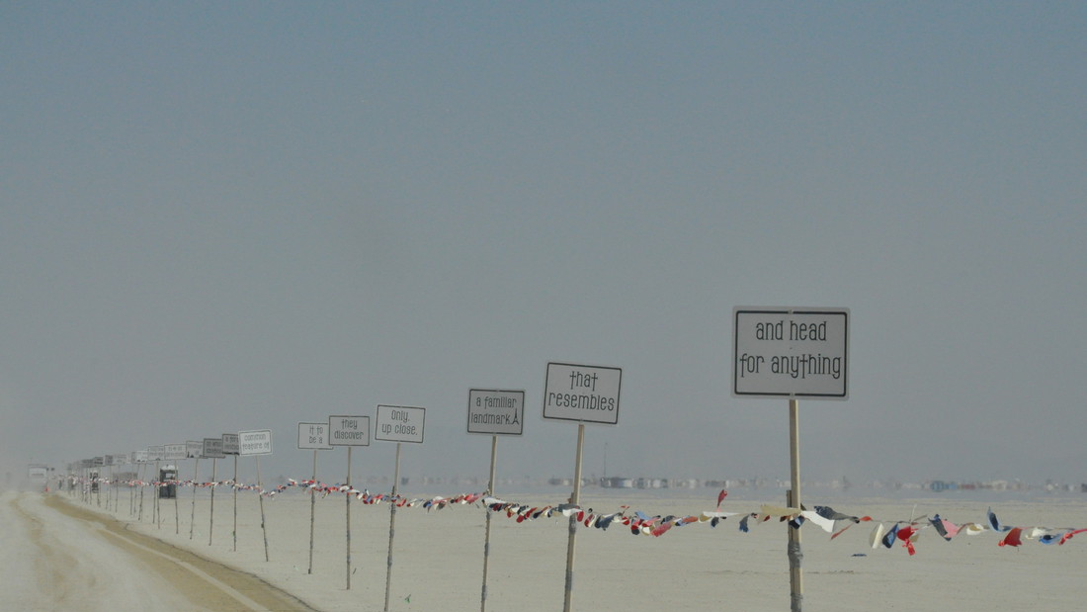
4 You need to bring everything
with you. Everything.
Notes:
Radical self-reliance means you need to bring a lot of stuff with you. A LOT.
Basically none of this is available to purchase on-site, or even in any of the nearby towns, so you need to make all your arrangements ahead of time.
A lot of us collaborate with our fellow campers on shared camp infrastructure like shade, and some groups chip in together on water or food. But whether you’re traveling solo or in a group, YOU need to make sure all your stuff gets to the playa.

Slide 35
Drinking water
1.5 gallons per day per person
Fun fact: That’s about 87 lb. of water for a week, per person
Buy in bulk please, not small bottles
Electrolytes (salt), not just water
Notes:
Remember what we said about low humidity? The water in your body is going to start wicking off into the atmosphere as soon as you set foot on the playa. Survival experts say you need a minimum of a gallon of water per day, and more if you want to do things like eat food or drink alcohol. 1-1/2 gallons per person should keep you alive and healthy, with maybe a little left over for brushing your teeth or washing a few dishes.
For a week’s stay that’s over 80 pounds of water, which is why if you’re riding the Burner Express Bus or flying in on Burner Express Air, you need to make other arrangements to get your water to your camp.
Please don’t bring a bunch of disposable water bottles – it’s better to bring big jugs and a refillable water bottle.
And one last tip: your body will do a better job at retaining water and staying hydrated if you take in electrolytes, like eating salty foods. Bacon: it’s a health food!

Slide 36
Shelter
Tents, domes, campers, trailers, yurts
The stakes that came with most tents are junk – use heavy spikes or rebar
Cap your rebar – prevent injuries
Shade cloth for your tent
Bedding cover – keep the dust off
Notes:
The Black Rock Desert is known for its beautiful skyscapes, and there’s nothing wrong with sleeping under the stars. Until there’s a whiteout, or a rainstorm, or the sun comes up and starts baking you like a crispy cookie.
You’ll see all kinds of shelters out there, and you’ll see a lot of them with their screens and vents covered to keep the dust out, at least during the day. You will also see ginormous tent stakes made from rebar or construction spikes, because the ones that they give you with your tent or pop-up shade are worthless on the playa.
Do us all a favor and cap off the exposed ends with tennis balls, empty plastic water bottles, or something to keep me from stepping on it in the dark. It’s also courteous to flag any guy lines.
And when the big yellow sun comes up in the AM, you will thank yourself for bringing some shade cloth and something to hold it up over your tent, like a small EZ-up. Otherwise it’s going to get mighty hot in there, mighty fast when the sun comes up.
And when you do button up your tent for the day, it’s nice to have a sheet or tarp to throw over your bedding, to catch the dust while you’re away having fun.

Slide 37
Food
You’ll eat less than you normally do
Salty/savory foods = electrolytes = delicious
Remove excess packaging at home
Food safety – coolers & ice, kitchen hygiene, common sense
Notes:
Food. You’re going to want less of it than you usually do, thanks to the dehydration effect. It takes a lot of water to digest food, and it’s natural for your body to respond by suppressing your appetite.
You may also find yourself craving salty and savory foods like cured meats and cheeses – the electrolytes will help you retain more of the water you drink.
When you’re packing your edibles, do yourself a favor and get rid of excess packaging before you leave – precycling – so there will be less garbage going home.
Try to keep your kitchen clean, and your cold food cold – use common sense about food safety. Because it would suck to miss Burning Man because of something you ate.

Slide 38
Clothing
Utility, comfort, self-expression
Minimize MOOP
Boots for walking, slippers for camp
Beware “playa foot”
Clean socks are awesome – bring extras
Bring clean clothes for exodus, keep in a Ziploc and don’t touch until you’re leaving
Notes:
As a rule, Burners don’t travel light. And a big chunk of what we haul out there and back is out of the clothes closet. We already talked about the temperature differences between night and day, and the need for both cool and warm outfits, but there are other factors in the wardrobe equation. Like style! Day or night, cutting a fashionable figure on the playa is a popular form of self-expression.
Steer clear of any bits and pieces that might come flying off in a windstorm, like sequins and feathers, and don’t pack anything that can’t hold up to a stiff breeze.
One look that’s not recommended is the barefoot look. Too much playa dust on your feet can lead to the dreaded “playa foot” syndrome, which if it goes far enough could have you stuck in your camp with your sorry feet in a vinegar bath while everyone else is out having fun. Something easy-on and easy-off, like slippers, are great for in camp. And when you go walkabout, some good comfortable boots.
After a few days on playa, changing into clean socks will feel like a spa day. And if you bring enough for two changes a day, it will be a spa weekend.
One last pro tip: pack a clean set of clothes in a Ziploc for the drive home, and don’t touch them until you’re leaving. You may still be crusted in dust, but at least your outfit will feel fresh.

Slide 39
Personal survival gear
Water bottle, goggles, dust mask
Flashlight / headlamp
ID if you’re going to be drinking (tape a photocopy to your cup!)
Medication in marked containers
Sunblock, chapstick, lotion
MOOP bag
Notes:
No matter what else you bring, there are a few essential items that you’ll always want to have within arm’s reach. Experienced Burners pack these up in a go-bag, or a utility belt, or something else that’s easy to tote when you go off adventuring.
Goggles, dust mask or bandana, water bottle; check check check.
Personal illumination, meds, unguents for skin survival, and a MOOP bag for toting your trash back to your camp. If you smoke, you’ll want some kind of portable butt can, like a mint tin.
And if you have any hopes of obtaining libations at anyone’s theme camp, bring your own cup and your ID. Many Burners photocopy their ID and tape it to their cup so it’s always there when they need it.

Slide 40
Personal illumination
At minimum, a flashlight or headlamp
Consider more radical illumination, i.e. EL wire
Illuminate front and back – please don’t get run over at night!
Notes:
Burning Man would appreciate it very much if you don’t get run over at night, so please illuminate yourself. In the dark of night, and it can get very dark, you don’t want to be mistaken for a patch of night sky and get hit by a vehicle, a bicycle, or another pedestrian.
You don’t have to light up like the Main Street electrical parade – just a simple flashlight will do, or some EL wire wrapped around your fuzzy hat so we can see you coming and going.

Slide 41
Wheels
Don’t bring your nice bike
Personalize and decorate
Fat tires work best in the dusty dunes
Lock it up
Light it at night
Take it when you leave
Notes:
You don’t absolutely need a bike at Burning Man. Plenty of people walk it, or borrow one of the free yellow bikes, or hitch a ride on an art car now and then. If you do bring a bike, know in advance that the desert is going to be pretty hard on it, and don’t bring your fancy racing bike.
A beater with fat tires, headlight and tail lights, and some personalized blingification is ideal – the more distinct the better, so you can spot it easily in a line-up. And lock it up when you’re not riding it, just like you would in any other city of 70,000 people.
There’s next to no crime in Black Rock City, but when it comes to bikes, what can I say? Sometimes mistakes get made. Oh, and try to remember where you park it, because that mistake can look like the other kind of mistake if I’m not mistaken.
Finally, be aware that Burning Man does not provide bike removal service at the end of the event. So don’t be that dishrag who just abandons his wheels at the end of the week and expects someone else to take it as a “gift.”

Slide 42
Something to share
Gifting: It’s a Principle!
First time? Don’t worry about bringing trinkets
Hugs, positive interactions, helping out where you can
Notes:
If you’ve gotten serious about your radical self-reliance, you probably brought too much of something. And there’s always that one thing you forgot to pack. But these problems have a way of working themselves out through gifting.
Don’t feel like you need to bring a bunch of stuff to give away, that’s not what it’s all about. It’s not like you got invited to Christmas at the neighbor’s house and need to put a trinket in everyone’s stocking. In fact, Christmas is a good reference point because it’s exactly the kind of gifting we don’t want to encourage – that “oh you gave me a gift, now I have to give you something back” business.
Gifting for its own sake may take some getting used to, so if it’s your first time, just let it happen and be appreciative when it does. Offer to help someone out, or give a random compliment.

Slide 43
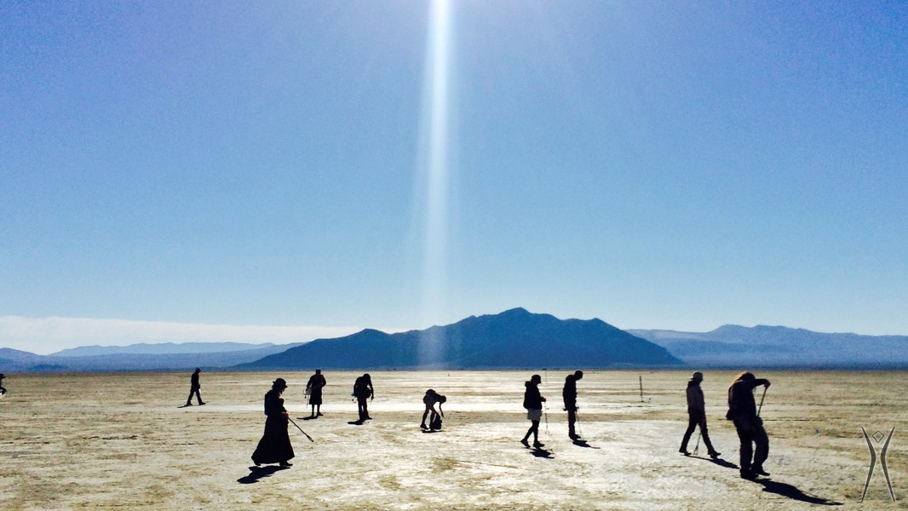
5 We can’t leave anything behind
when we go. Nothing.
Notes:
Next on our Top Ten list: Leaving no Trace! This is a Principle that means exactly what it says: when we leave, we take everything with us. Everything! The playa is a completely empty wilderness, not a bush or a twig or a rock – and we like to keep it that way. In fact, we have to keep it that way: it’s a condition of our use permit with the federal government. But it’s more than, it’s a philosophy, even a way of life. So let’s talk some trash.

Slide 44
Matter Out Of Place
During event: don’t let it hit the ground, don’t let the wind get it, always be MOOPing
Before you leave: line sweep your camp, spend 1-2 hours MOOPing the area
On the way out: secure your load; roadside MOOP is not cool
Notes:
Trash is a relative word. As the saying goes, “one man’s trash is another man’s treasure.” So we don’t use that word much. Instead, we talk about MOOP: Matter Out of Place. Which is anything where it’s not supposed to be, like on the ground, unsecured, rather than in your camp in a trash bag or in your tent. In any other city, or at a festival somewhere, you might be able to get away with, say, dropping a cigarette butt on the ground, and count on someone else to pick it up. But on the playa there is no someone else: just us! So you may need to develop some new habits.
When you’re out there, keep your stuff secured, whether it’s trash or treasure. Don’t let it hit the ground, where the wind could send it flying, or bury it under a dust dune.
ABM: Always be Mooping. Develop the habit of scanning the ground wherever you go, and picking up stray stuff. You’ll be glad you did when you get to the end of your trip and you’re breaking down your camp. The standard practice then is to line up all your campmates and slowly walk from one end of the camp to the other, in line abreast formation, picking up MOOP as you go. Then do it again! Then spend an hour or two MOOPing around your camp, in the roads, in unclaimed space, in your neighbor’s camp.
And on the way home, make sure your trash and recycling bags are secured, either inside your vehicle or covered and securely strapped. Every year a few clowns screw this up and leave a MOOP spill on the highway, which makes us all look bad. So don’t be that clown!

Slide 45
Matter Out Of Place
Take it all the way home or pay to dump it – don’t just leave it somewhere
Motor oil is MOOP – does your car leak? If yes put down something to catch it
Wood chips and sawdust are MOOP – cut beforehand or work over a tarp
Shovel, rake, bucket, etc.
Notes:
Another chump trick is to drive as far as the nearest rest stop, or gas station parking lot, and ditch your trash there. Not cool! Unless someone agrees to take it from you, like for cash, you need to take it to a dump or take it all the way home.
A few things that might not sound like MOOP, but are MOOP, and need to be controlled. Does your car have any leaks? Oil is MOOP, power steering fluid is MOOP – so you need to catch it while it’s parked, or shovel it up if you don’t.
Wood is MOOP, actually, the number one offender according to our Playa restoration team. So do your cutting and sanding before you get here, or if you do woodworking on the playa, put down a tarp, wait for low wind, and clean it up as soon as you’re done.
Finally, bring some basic tools to make your MOOPing easier: a rake, a shovel, a bucket – for extra credit bring a MOOP stick – which is basically a long pair of tongs. Pro tip: empty 2-1/2 gallon “suitcase” style water containers make excellent MOOP buckets if you cut off one of the ends.

Slide 46
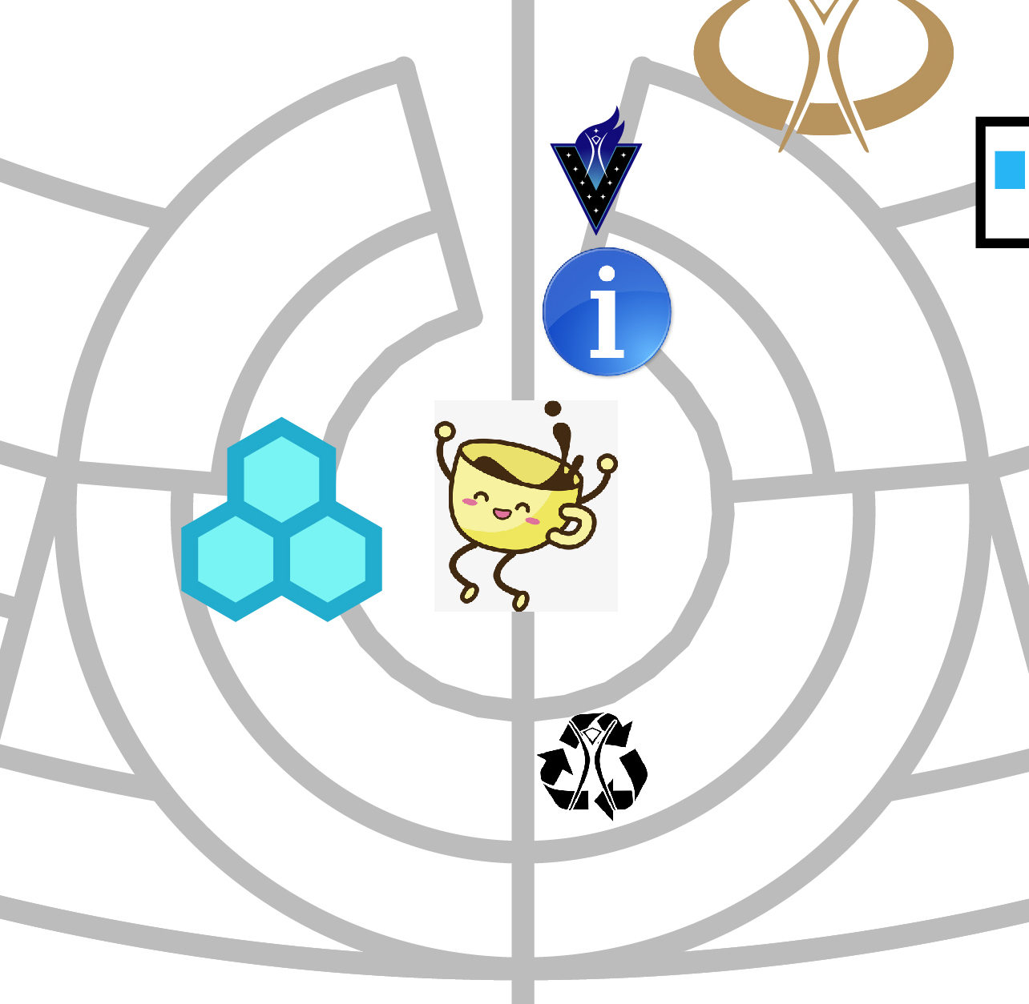
Recycle Camp
Accepts clean, dry aluminum ONLY
Proceeds benefit local community
Notes:
On the city map you’ll see “Recycling Camp” right below Center Camp Café. Be advised they only accept clean, dry aluminum cans. All the cash form this goes back to the local community. For all other kinds of recycling – glass, plastic, whatever – you are on your own. And we trust you will do the right thing. Radical self reliance!

Slide 47
Portapotties
Toilets – the basis of civilization!
“If it didn’t come from your body…”
Be respectful, keep it tidy
You’ll need a headlamp at night
Bring a bucket and trash bags for emergencies
Notes:
Burning Man’s sanitation infrastructure is based on the humble portapotty. So please take advantage of the service – because human waste is arguably the nastiest sort of MOOP. Not to mention a biohazard. Thank you in advance for using the portapotties respectfully, in a manner that promotes their continued operation. I
f you put ANYTHING in there besides human waste and 1-ply paper, it clogs the tubes, fouls the machinery, makes it a nightmare to clean, and otherwise threatens the fragile basis of our civilization. So as the saying goes, if it didn’t come out of your body, don’t put it in the potty. Also be advised that portapotties are not trash cans, so don’t leave your cans, bottles, butts, or whatever in there.
Potties are not lit at night, so bring a flashlight. And in case of weather emergency, like a rain storm or a whiteout, it’s advisable to have a backup can in your camp – a 5-gallon bucket with a lid and some trash bags will do in a survival situation.
Finally, a note to all the guys out there: I know that when we’re camping, it’s tempting to go all nature-boy and pee on a tree. But there are no trees on the playa, and urine is MOOP. So hold it until you get to the can, ok? Thank you gentlemen.

Slide 48
Gray water
“Used” water, not of the toilet variety
No disposal on the playa!
Put it in empty containers and pack it home (bring a funnel!)
Forget those evaporation contraptions
Notes:
Between blue water – what we drink - and black water – what gets pumped out of the toilets – there is gray water. Dirty dishwater, used shower water, the ice melt in your ice chest. Even if it looks clear –or clearish – don’t dispose of it on the playa.
You need to pour it back into empty containers and pack it out with the rest of your MOOP. In my camp we bring an empty barrel with a locking lid and a big funnel, and it does the job nicely.
As you’re preparing for the event, you may run across plans for various evaporative contraptions that promise to wick all your gray water away into the atmosphere. Sounds good on paper, but too often they just make a giant muddy mess.

Slide 49
LEAVING NO TRACE
“
We are committed to leaving no physical trace of our activities wherever we gather. We clean up after ourselves and endeavor, whenever possible, to leave such places in a better state than when we found them.
“
Notes:
At the risk of repeating myself, this is really important. Leaving No Trace is one of our guiding principles, and we take it very seriously. So if you screw up in the MOOP department, don’t be surprised if someone volunteers to school you on your errors. Don’t take it personally. We’re all in this together.

Slide 50
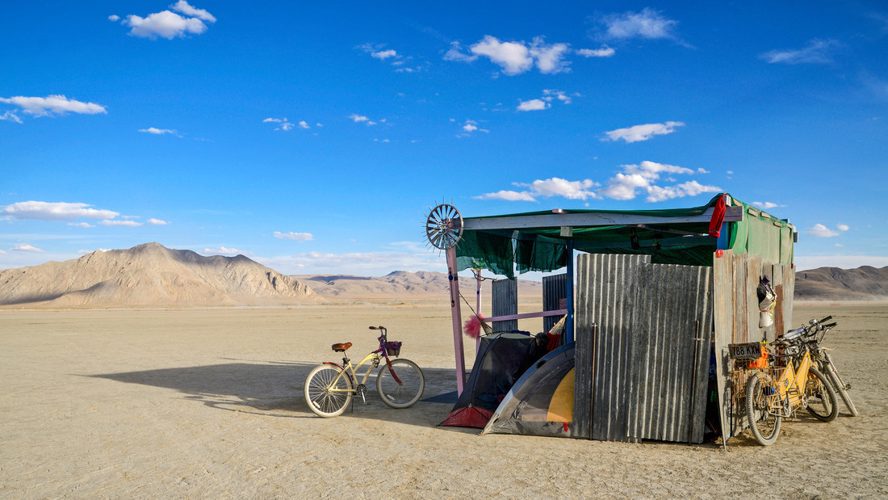
6 You can camp with friends.
Or make new ones.
Notes:
Number the sixth. It is a camping trip, but we’re not going to tell you how to camp. Theme camps, open camping, or the walk-in zone - you get to choose your own adventure.

Slide 51
Theme Camps
Pre-event Placement process
Public-facing role: providing interactive experiences for all of us
Membership determined pre-event, may have camp dues
Communal effort, shared infrastructure
Notes:
Each year, the hard-working volunteers on our placement team review a ginormous stack of forms submitted by groups seeking advance placement for their theme camps. Nearly 1,000 of them are placed on the map before the city is even built – provided they agree to abide by established guidelines for interactivity and neighborliness.
Some people argue that theme camps are the native art form of Burning Man, creating interactive experiences ranging from yoga studios to nightclubs, and offering them as a gift to all.
If you’re with a theme camp, you’ll need to get on their membership roll well before the event, and many camps have dues to share the cost of shared infrastructure.

Slide 52
Open camping
First come, first served
No land grabbing!
Notes:
The shaded areas are a VERY rough approximation of reserved camping for interactive theme camps. Notice that the shaded edges are soft. On the playa these reserved areas are marked with small blue survey flags [TS]. If you’re not with a placed camp, you’re going to be camping in one of the Open Camping zones. Open camping is first-come, first-served. And you need to actually set up your camp – just putting an ice chest out there and trying to stake a claim won’t work. No land grabs!

Slide 53
Walk-in camping
No cars; walk in your gear and supplies
Located on outskirts of BRC between 2-5 o’clock
Notes:
As a rule, people don’t travel to Black Rock City for peace and quiet, but if you’re looking for the chill side of town, with maybe a little less cacophony, it’s out toward the airport, on the outskirts of the city between 2:00 and 5:00 streets.
It’s a walk-in zone, so the odds are good that you won’t have any generators or big sound systems near your tent.

Slide 54
Wherever you camp…
Get to know your neighbors
Everyone in camp should know where to find the nearest essentials (Ranger station, 1st Aid, ice sales, etc.)
Decommodify your camp: hide or hack rental company logos on vehicles
Notes:
Wherever you camp, that’s going to be your neighborhood while you’re here, so get to know your neighbors. Remember, this is a survival situation, and we’re all in it together. Making friends with the folks on the other side of that imaginary property line in our imaginary city is important, so do it. And the more of you who know the more of them, the better – it’s called neighborliness.
Everyone in your camp should also know where to go for all the essentials: the nearest ice station, ranger station, and so forth.
And a note on appearances, because we’ve all got to look at each other’s camps: corporate logos are viewed by many to be a form of eye pollution, and not in line with our principle of Decommodification. So thank you in advance for hiding them or hacking them with clever alterations – sometimes all it takes is a roll of blue tape and a little imagination. Your neighbors will thank you for it.

Slide 55
PARTICIPATION
“
We achieve being through doing. Everyone is invited to work. Everyone is invited to play. We make the world real through actions that open the heart.
“
Notes:
One of our favorite principles – okay, top 10 anyway – is Participation. In the early days we used call it ‘NO SPECTATORS.” But then we realized that if there’s no audience, there’s no show – it’s like that proverbial tree falling in the forest. So it’s okay to do both: create and observe. But the essence of this is that Burning Man is not just a state of being, it’s a culture of doing. It’s a do-ocracy! So don’t just stay in your trailer, get out there and be part of the action!

Slide 56
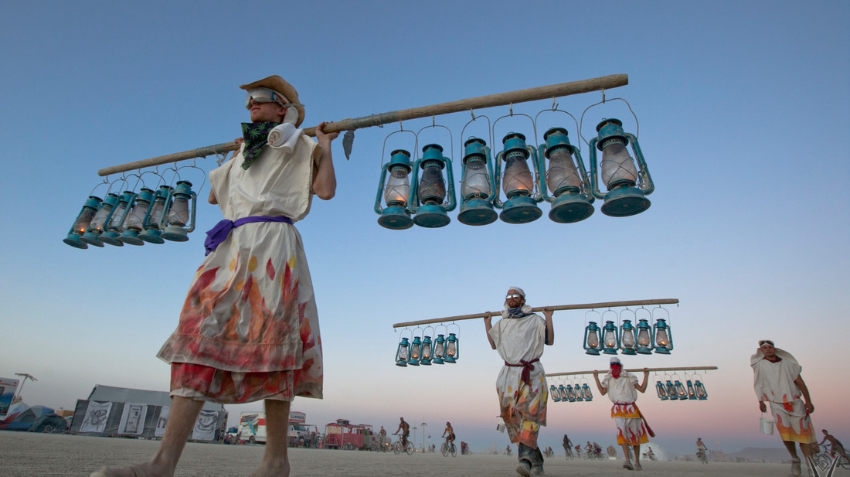
7 It’s more fun if you participate.
Notes:
Sometimes when people find out it’s not a music festival, they get this puzzled look and say “well what IS it then? What do you DO out there?” There are as many answers to that as there are Burners. Yes you can go out and dance your tail off every night, no problem. But that’s not even the half of it.

Slide 57
Go adventuring
Theme camps, interactive art, exploring deep playa
What Where When Guide
The map is not the territory
Notes:
Theme camps offer a million and one forms of interactivity. And there’s art like you’ve never seen before: fire art, interactive sculpture, mobile art, performance art, and genres that haven’t been named yet.
Some of this takes place in town, but most of the heavy art is out on the open playa, in the part of our city beyond the neighborhoods. The further out you go into “Deep Playa,” the weirder it can get, and the more unexpected surprises you may encounter.
Some of this will be in the guidebook you get at the gate, the WhatWhereWhen guide, and a lot of it will not. Remember that all times are approximate, some listings may be pranks, and the map is not the territory. That’s why we call it adventuring.

Slide 58
Getting around
Mutant vehicles
If there’s room, anyone can ride
No custom rides or return trips – you go where they’re going
Mobility camp - pimp your chair!
Notes:
Most people bring a bike but there are other ways to get around. As a condition of their registration, mutant vehicles are expected to give a ride to anyone who asks, as long as there’s room aboard.
They’re not taxis – you go wherever they want to go, and stop wherever they stop. And for safety’s sake, do NOT get on or off unless the vehicle is at a complete stop.
For those of you with mobility issues, there’s good news and other news. The good news is: no hills! The other news is: playa dust can pile up in dunes that are hard to maneuver a chair through, and the dust can be hell on electric motors. The folks at Mobility Camp – another awesome volunteer enterprise – love to share what they know about practical modifications that can make rolling around the playa a better experience.

Slide 59
Meeting people
Talk to strangers
Get to know your neighbors
Notes:
When you talk to people who’ve been to Burning Man and ask them what was good about it, nearly everyone is going to talk about the people they met. Even introverts have a way of making new friends out there.
It may be the world’s densest concentration of genuinely interesting people, and most of them are ridiculously easy to strike up a conversation with. I’m not saying there are no assholes or idiots – hey, it’s a big city – but they’re not as common as you might think. So say hi to a stranger, and see where it goes.

Slide 60
Volunteering
Citizenship – a way to give back
Infrastructure as art
Have fun, make friends
V-Spots place walk-up volunteers
Notes:
Burning Man is not for everyone. Let’s be clear about this: a lot of people go once, and never go again, and that’s perfectly okay. But the ones who love it, and want to come back, usually want to get involved in a deeper way, to contribute, to participate.
A great way to do that is to join the small army of volunteers who make it all possible. We’ve figured out how to make our infrastructure an art project, and have fun doing it.
Many teams accept walk-in volunteers during the event – if you’re interested, stop by the V-Spots, next to Playa Info on the Center Camp Circle, or near the Rangers Outposts and Medical Stations behind the 3:00 and 9:00 and B plazas[TS], and see what’s available.

Slide 61
IMMEDIACY
“
We seek to overcome barriers that stand between us and a recognition of our inner selves, the reality of those around us, participation in society, and contact with a natural world exceeding human powers.
“
Notes:
Did we mention immediate experience? It’s pretty amazing. Getting outside of yourself and your little social media bubble. Having a genuine experience of other people and the natural world. It’s not for everyone, but for many it’s the most amazing thing about Burning Man, and what sets it apart from everything else in their lives. It’s – what’s the word I’m looking for here – Real. Really, really real.

Slide 62
A note about cell phones
Coverage is spotty, especially later in the week
Heat and dust may lead to poor performance – don’t be sad, be glad
Be respectful when taking pictures or video
Notes:
A few years ago, this note wouldn’t have been necessary. There just wasn’t any coverage out there in the wilderness. But with recent expansions in the commercial cellular networks, you may now be able to get service during at least part of the event. The big question is: do you want to? For many participants, it’s a rare opportunity to go offline for a week, put the phone in a ziplock bag, and experience some old-fashioned human interaction and immediate experience.
If you can’t bear to part with your phone for even a few days, be advised that the environment is going to be rough on the equipment. Batteries don’t charge well in the heat, and dust gets in all the nooks and crannies, like your camera lens.
And speaking of cameras, please be respectful when taking pictures of people: ask permission first, and respect privacy concerns.

Slide 63
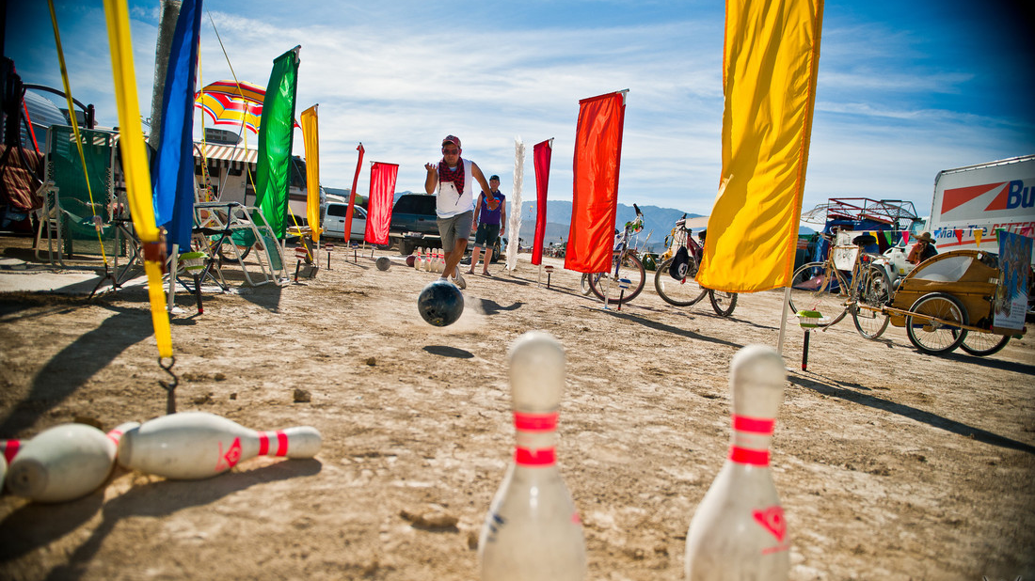
8 How to have a great burn
Notes:
Number 8 on our top 10 list is actually its own mini list of pro-tips. If you’re going to go, we want you to show up prepared and have the time of your life.

Slide 64
Before you go
Read the survival guide
Contemplate the 10 Principles
Be well-rested and ready for adventure
Notes:
As I’m sure you’ve figured out by now, Burning Man is not just a spur-of-the-moment, jump-in-the-car-and-go sort of event. It takes a lot of advance planning and preparation. At a bare minimum, you and everyone in your camp need to read the Survival Guide – a paper version ships with your tickets, and an electronic version is up on the burningman.org website. It’s kind of long, but none of it is fluff – this is all stuff you need to KNOW.
Including the 10 Principles, which we’ve been not-so-subtly slipping into your drinks throughout this presentation. Reading up on the culture is the key to living large like a local, instead of sticking out like a tourist, in Black Rock City.
And if you can, try to catch up on your sleep and drink lots of water before you go. Just saying.

Slide 65
Personal safety
If you die at Burning Man, you die in the real world too
Watch for signs of stupid
Illuminate at night – don’t be a darkwad
Caution around all vehicles – slow is still dangerous
Notes:
Compared to other cities of its size, Black Rock City is a really safe place. But it’s still a city, and a wilderness survival situation to boot. As the saying goes, if you die at Burning Man, you die in the real world too. And that really sucks for you. And for us too: all the mourning and grieving, the candlelight vigils, the grief counseling. So please be good to yourself, and considerate to the rest of us, and stay safe. Thank you for not dying at Burning Man!
Less of a bummer than dying, and considerably more likely, is some form of personal injury that will send you home early, or at least take all the fun out of your trip. Cuts, burns, puncture wounds, broken bones – that sort of thing. All treatable, but not fun. Being hot, underhydrated, and possibly buzzed – all of these can make you sloppy, so “watch for signs of stupid” in yourself and others. Take a break, drink some water, and take a time out.
Illuminate yourself when you’re traveling at night so people don’t run into you.
And be extra cautious around vehicles of any kind. That giant three-story disco bus may be going slow, but with something that big, slow is still dangerous. Give it a wide berth, and don’t approach unless it’s at a full stop.

Slide 66
Camp safety
Thank you for not burning, man
Stakes and wires – cap and flag
Secure everything against the wind
Notes:
In a city with so many tents and temporary structures, fire safety is super important. If you bring a firepit or chiminea, you need to keep it attended at all times, and douse that fire if the wind picks up. Or if you’re the last one up at night.
Tent stakes and guy lines should be capped and flagged, so no one gets tangled in the rigging at night.
And as we’ve already said, EVERYTHING needs to be secured against those sudden gusts of wind.

Slide 67
Emotional health
Expect to experience the full range of human emotion
Take care of yourself (meds, vitamins, water, food)
HALT (Hungry, Angry, Lonely, Tired)
If everyone’s a jerk today – is it possible that I’m the jerk?
Notes:
With all the fun you’re going to be having, it’s easy to forget that you’re in a desert survival situation. This can be just as taxing on your mental and emotional health as your physical well-being. Mood swings may be more pronounced than usual, and many report going through a wide range of emotional states, even the full range.
The best thing you can do for this is to take good care of your physical health: hydration, blood sugar, vitamins, medications.
Look for signs of HALT in yourself and your friends: are you hungry? Angry? Lonely? Tired? If so it might be time for a time-out: some water, a snack, maybe a nap.
Finally, if you find yourself having one of those days when everyone around you seems to beacting like a jerk, take a step back and check the mirror. YOU could be the one having the HALT experience.

Slide 68
Neighborliness
Be excellent to each other
Respect people and their art
Sound considerations
Look out for your fellow Burner
Notes:
One of the reasons so many people have so many good times at Burning Man is that people are, on the whole, exceptionally nice to each other. What goes around comes around, and the Golden Rule is in full effect. Be excellent to your neighbors, and they are highly likely to be excellent to you.
Be respectful of people and their art – even if it’s meant to burn, that doesn’t mean you have the right to fuck with it.
Try to be a good neighbor and be considerate of your neighbor’s sensitivities: loud music and so forth. In general, look out for each other. Communal effort! We’re all in this together.

Slide 69
If lost or broken…
Self-reliance; then Emergency Services
Bring all your meds
If you need help, find anyone with a radio (or just call out for help in a crowd)
Notes:
If you get hurt on the playa – physically, mentally, emotionally – the first thing you should do is a radical self-reliance check. Can I take care of this myself?
Did you bring a first aid kit and all your meds?
If you can’t fix yourself, or your friend, or that weird stranger who wandered into your camp in bad shape, your next stop is Emergency Services. Like I said earlier, everyone in your camp should know where the nearest medical station is located. And if it’s an emergency, and someone can’t make it to care on their own, start calling for help, fast.
Don’t use your phone to call 911, instead you should grab anyone you see with a radio and ask them to call it in. Or if there are no staff people in sight, just start yelling for help. We love radical self-reliance, but we also believe passionately in taking care of each other. Burners don’t walk away from other Burners in trouble, they help out.

Slide 70
RADICAL INCLUSION
“
Anyone may be a part of Burning Man. We welcome and respect the stranger. No prerequisites exist for participation in our community.
“
Notes:
There are countless subgroups within the Burner community: volunteer teams, theme camps, art crews, even that little clique of you and the people you rode out with. What we all have in common is that we try to show up with an open mind, and not judge on appearances. Now that doesn’t mean everyone has to like everyone, far from it, but we ask that you give people the benefit of the doubt. We welcome and respect the stranger, and believe that what people do is a lot more important than what they look like or where they’re from.

Slide 71
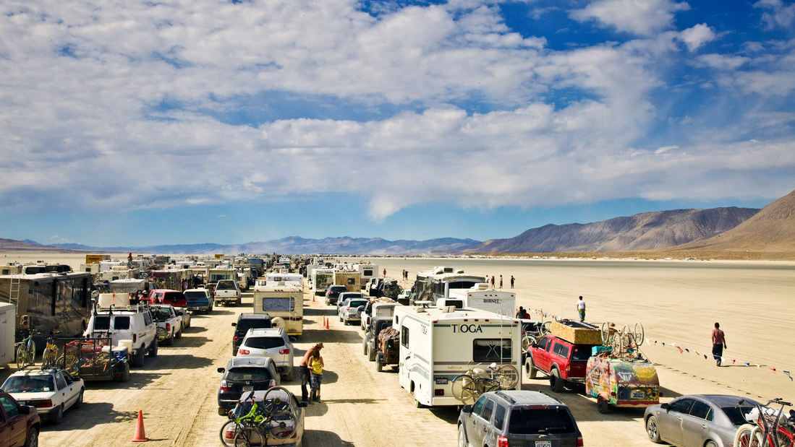
9 Getting there may take a while.
Leaving too. Relax & enjoy.
Notes:
Tip number 9. I hate to break it to you, but getting in and out of our fair city can be, um, challenging. It’s a little ironic, but part of the price we pay for having a beautiful car-free city is that there can be traffic jams getting in and out of town. It’s a pain, but the crew is constantly working on little ways to make it better. Think of it this way: no matter how you go, by land or by air, with old friends or new ones, it’s going to be an adventure just getting there, and another one getting home.

Slide 72
Many ways to go
Many options for rideshare and carpool
Burner Express Bus and Air
Reno’s Air Playa Info
Notes:
It takes a LOT of cars and trucks to get 70,000 people to and from the middle of nowhere, and anything we can do as a community to reduce that number is good. That’s the main reason why people have to buy a vehicle pass for every set of wheels at the event – it’s an intentional disincentive. Carpooling and ridesharing are the way to go if you’re driving – check the burning man website for ways to connect.
Minimizing vehicle traffic is also the reason we’re working to grow the Burner Express Bus and Burner Express Air programs.
And of course there’s the fly-drive option, with thousands of participants flying into the Reno airport, and finishing the trip by renting a car or taking the Burner Express bus. Fun fact: Burning Man is the busiest season of the year at Reno Airport, busier than Christmas or Thanksgiving. So many people, in fact, that Burning Man volunteers staff a Playa Info satellite inside the airport to help all those Burners get where they’re going.

Slide 73
Driving – before you go
Unobstructed license plate
Check lights, brakes, etc.
Secure your load – then stop and secure it again
Ticket to forehead
Twitter traffic updates - @BManTraffic
Notes:
If you’re going to be rolling into Black Rock City, do a thorough vehicle check before you head out. If your rear license plate is blocked by bikes or anything else, you should move it to where it’s visible, or risk getting pulled over on the way in.
Make sure all your lights and signals are working properly, and that your load is strapped down tight. Then pull over after a little driving and strap it down again – loads tend to shift once you’re on the road.
And do a ticket check: make sure everyone in the vehicle has theirs. Don’t take their word for it either: have them get it out and hold it up to their forehead. Don’t laugh, you just did a ritual!
If you’ve got your Twitter on you can get traffic updates from @bmantraffic.

Slide 74
Driving – Nevada roads
Open grazing - watch for cattle in road!
Ignore speed limits at your financial peril
Don’t expect to do any serious shopping within 100 miles of the site – small country stores only
Be nice to locals and local businesses
Notes:
Day or night, driving in Nevada’s back country is an experience in itself. There’s open grazing, which means watch out for cattle on the road – especially at night. Your route will also take you through Indian lands, and some small desert hamlets with very low speed limits – ignore them at your financial peril!
There are a few little country stores along the way, but don’t count on picking up any essential supplies once you’re past Reno. Or Winnemucca or Susanville, depending on where you’re coming from.
That being said, the local stores are still great places to stop, get out of the car, drop a few dollars, and meet the locals. Please be good neighbors to our Nevada neighbors, okay? Leave no trace, and for goodness sake keep your clothes on. Oh, and if you’re tempted to buy fireworks, don’t bother, they’ll just be confiscated at the gate.

Slide 75
Getting through the gate
Laws apply on Gate Rd: 10 MPH speed limit, seatbelts, no open containers
Each vehicle needs a vehicle pass, each person needs a ticket - have tickets ready
Box office is for will-call; no ticket sales
Notes:
Once your tires leave the payment and you drive out onto the playa, you’re on Gate Road. The speed limit is 10MPH, and it’s strictly enforced. You’re off road but all the rules of the road still apply: seatbelts on, no open containers.
Each vehicle needs a vehicle pass, and each person needs a ticket: did you do your ticket-to-the-forehead check? If anyone has a ticket waiting at Will Call, that’s okay – but everyone in the car needs to pull over and wait while they pick it up at the Box Office.
Just to be super clear about this, there are no ticket sales whatsoever on the playa or in nearby towns. Everyone needs to have a ticket, either in hand or at will-call, or the whole vehicle will get turned around.

Slide 76
Getting through the gate
Listen to GARS Radio 95.1
Stay in vehicle unless requested
All vehicles will be searched
Greeters: BRC map, stickers, city guide, hugs
Notes:
For traffic conditions on gate road, tune it to 95.1.
Once you get to the gate, your vehicle will be searched for stowaways or contraband like fireworks. Stay in your seat unless asked to get out – it will be over in no time.
Once you’re through the gate, you’ll make a second brief stop at the Greeters station – here’s where you’ll get your WhatWhereWhen guide, your city map, some shwag, and maybe a dusty welcome hug.

Slide 77
Exodus
Listen to BMIR before you go for timing info – expect delays
Expect “pulsing”
Listen to GARS Radio 95.1
Continue to be excellent to each other
Notes:
Fast forward to the return trip. Getting out of town is kind of like getting into town, only in reverse. Not literally in reverse, please use your forward gears. We call this the Exodus, and the best way to avoid long delays is to understand peak traffic times and try to work around them. Monday is the busiest day, so maybe you might want to think about leaving Sunday night? Or staying until Tuesday? And traffic is always lighter in the dead of night and pre-dawn hours, so maybe that works for your crew.
In any case, be ready to spend some time sitting. It’s a good idea to have some snacks and beverages handy, not buried in the back under all your dirty clothes.
In peak hours the Gate crew will regulate traffic with “pulsing” – letting a group of cars through, then a wait, then another group. Relax, you’ll get home eventually. Continue to be excellent to each other, and listen to GARS radio 95.1 for traffic conditions.

Slide 78
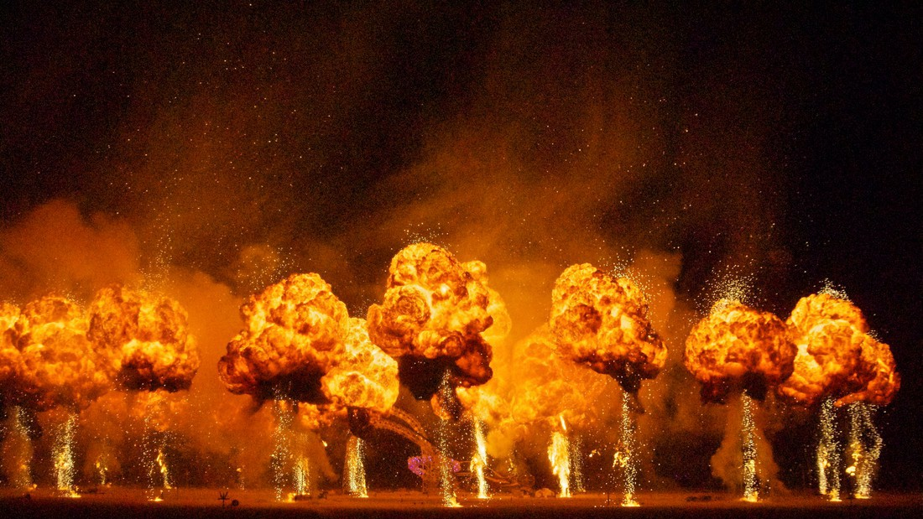
10 It’s not just once a year!
Notes:
Lastly, number the tenth: it may be over, but it’s not over! If you’re feeling those post-playa blues, there are a few things you can do. First, make sure you’re subscribed to the Jackrabbit Speaks newsletter, so you’ll be in the loop on next year’s ticket sales and other good stuff. And you know that Burning Man is a year-round thing, right?
There are over a hundred regional Burner groups, and over 60 official regional events all over the country and worldwide.
There are also Burners Without Borders chapters, a global art grants program, year-round theme camp crews – there are a million ways to stay connected and keep burning.

Slide 79
Staying in touch, finding out more
www.burningman.org
The Jackrabbit Speaks Newsletter
Burning Man Journal
ePlaya
Notes:
Everything you need to know is on the website, burningman dot org, including info on how to subscribe to the Jackrabbit, links to the blog, the Burning Man Journal, the ePlaya community, and more.
That’s all for now – have a great first burn!

Slide 80
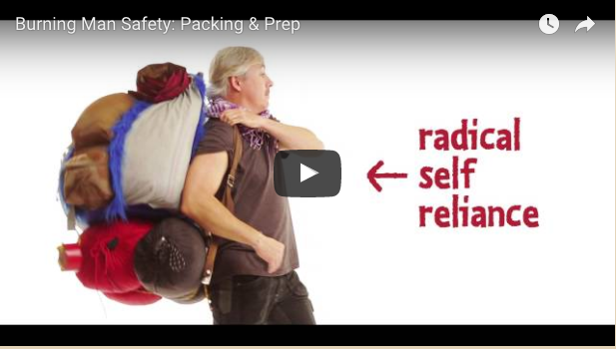
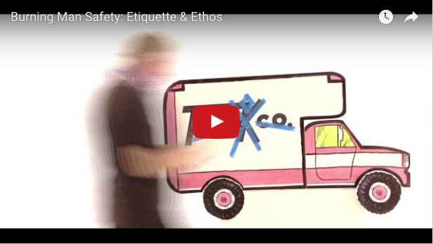
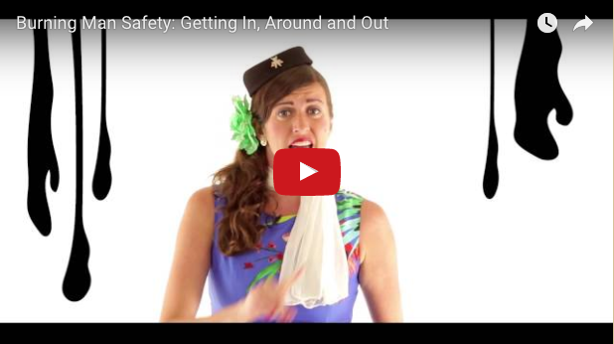
Watch these videos!
www.burningman.org/event/preparation/videos/

Slide 81
Thank you!
Any questions?

